Slide 1
OA3103: Data Analysis
Linear Algebra Review and Matrix SLR

Slide 2
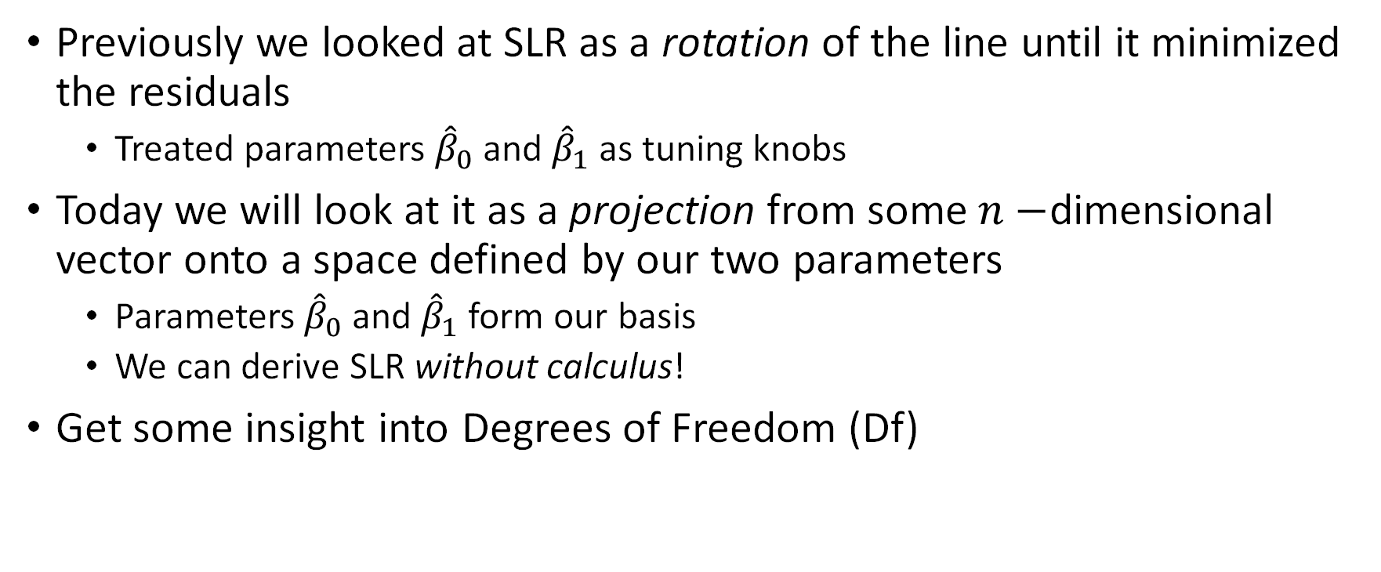
Goals for Today
Previously we looked at SLR as a rotation of the line until it minimized the residuals
Treated parameters ${\hat{β}}_{0}$ and ${\hat{β}}_{1}$ as tuning knobs
Today we will look at it as a projection from some $n−$dimensional vector onto a space defined by our two parameters
Parameters ${\hat{β}}_{0}$ and ${\hat{β}}_{1}$ form our basis
We can derive SLR without calculus!
Get some insight into Degrees of Freedom (Df)

Slide 3

Linear Algebra Warm-Up
Vector Notation
What they look like in $ℝ^{n}$ space
Vector addition (and subtraction)
Linear combinations of vectors
Dot Products
Projections

Slide 4
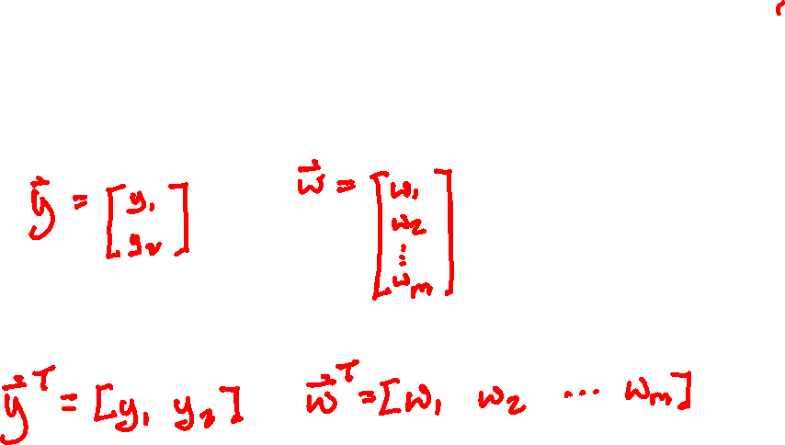
Vector Notation
We can write vectors as columns:
And their transposes:

Slide 5

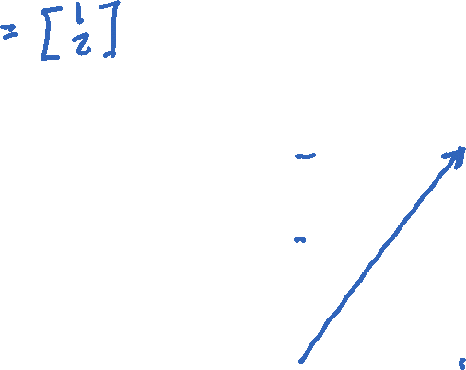

What Vectors look like in $ℝ^{n}$ Space
$Y=\left[\begin{matrix}y_{1} \\ y_{2}\end{matrix}\right]$
$$y_{2}$$
$$y_{1}$$

Slide 6
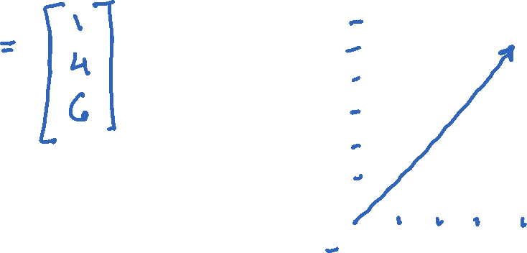

What Vectors look like in $ℝ^{n}$ Space
$$y_{3}$$
$Y=\left[\begin{matrix}y_{1} \\ y_{2} \\ y_{3}\end{matrix}\right]$
$$y_{2}$$
$$y_{1}$$

Slide 7
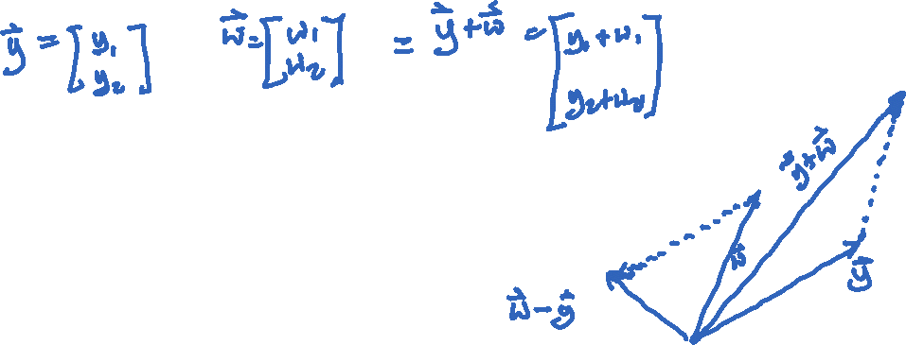
Vector addition (and subtraction)
If we add two vectors:
Subtraction:
$$y_{2}$$
$$y_{1}$$

Slide 8


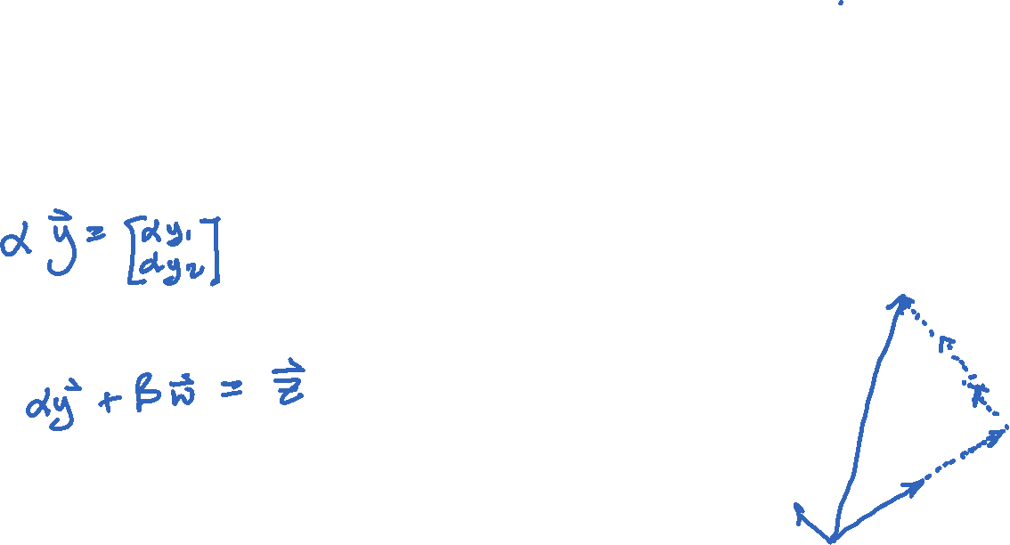


Linear combinations of vectors
What do I mean by “linear combinations”?
$$y_{2}$$
$$y_{1}$$

Slide 9

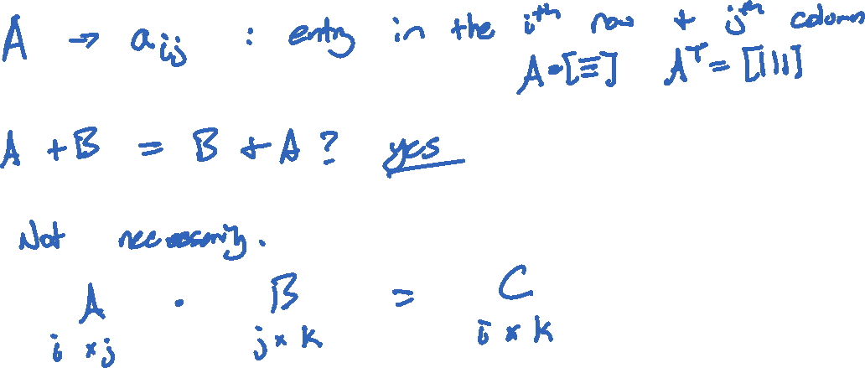
Matrix Notation
A matrix has $r$rows and $c$ columns.
Is addition/subtraction commutative?
What about multiplication?

Slide 10
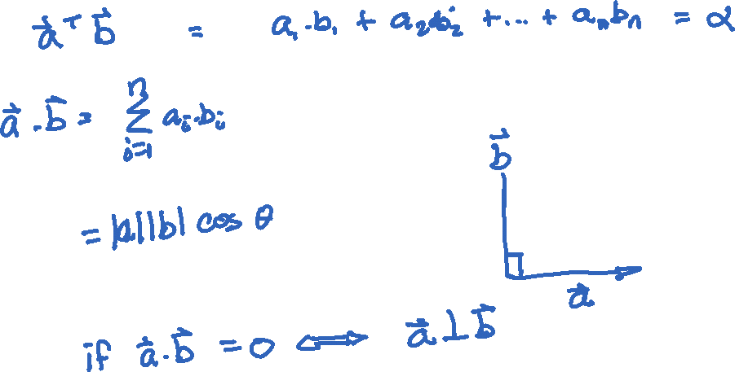
Dot Products and their properties
Formulas:

Slide 11
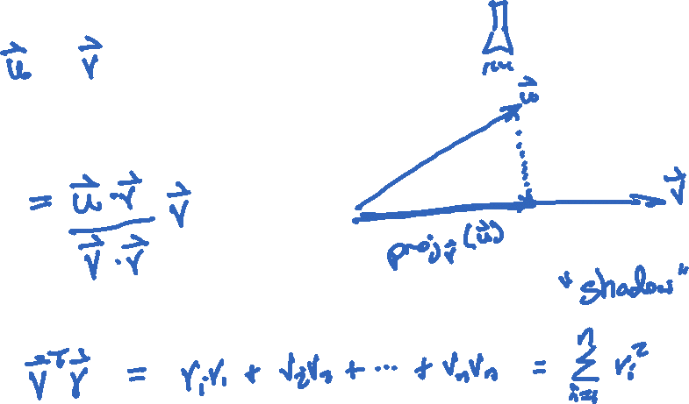
Projections
We can project a vector onto another vector:

Slide 12

The Linear Regression Problem
We have $n$ data points, $\left(x_{1},y_{1}\right),\left(x_{2},y_{2}\right),…,(x_{n},y_{n})$
We want to draw the “best” line through them but we are overdetermined.

Slide 13

The Linear Regression Problem
We have $3$ data points, $\left(x_{1},y_{1}\right),\left(x_{2},y_{2}\right),(x_{3},y_{3})$
We want to draw the “best” line through them but we are still overdetermined.

Slide 14

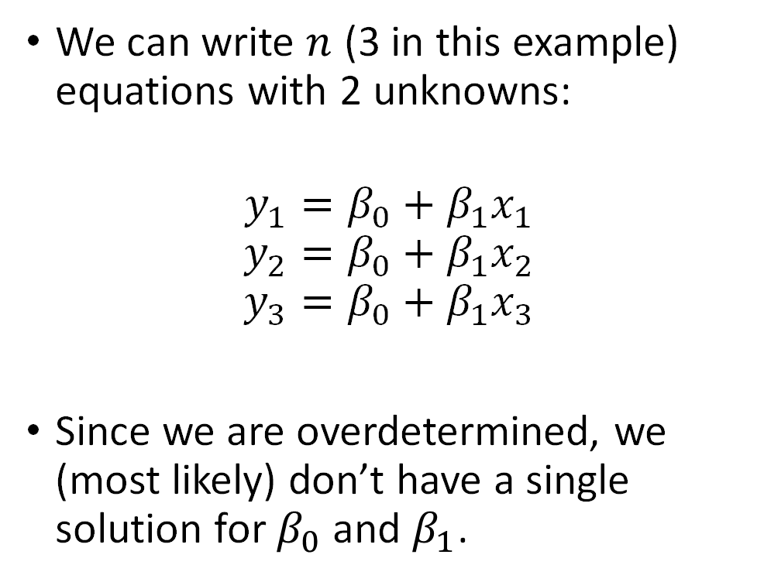


The Linear Regression Problem
We can write $n$ (3 in this example) equations with 2 unknowns:
$$y_{1}=β_{0}+β_{1}x_{1}$$
$$y_{2}=β_{0}+β_{1}x_{2}$$
$$y_{3}=β_{0}+β_{1}x_{3}$$
Since we are overdetermined, we (most likely) don’t have a single solution for $β_{0}$ and $β_{1}$.
$$\left(x_{3},y_{3}\right)$$
$$\left(x_{1},y_{1}\right)$$
$$\left(x_{2},y_{2}\right)$$

Slide 15
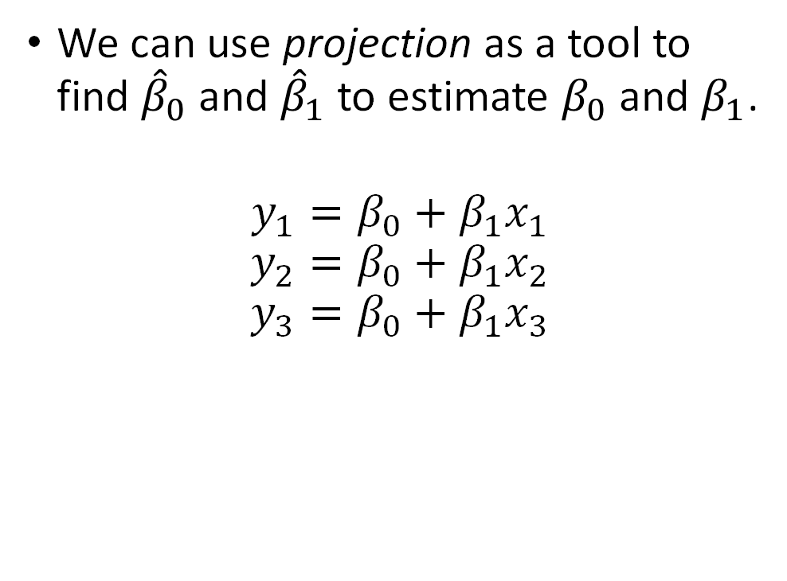
Linear Regression (This Time, Using Linear Algebra)
We can use projection as a tool to find ${\hat{β}}_{0}$ and ${\hat{β}}_{1}$ to estimate $β_{0}$ and $β_{1}$.
$$y_{1}=β_{0}+β_{1}x_{1}$$
$$y_{2}=β_{0}+β_{1}x_{2}$$
$$y_{3}=β_{0}+β_{1}x_{3}$$
$$\left(x_{3},y_{3}\right)$$
$$\left(x_{1},y_{1}\right)$$
$$\left(x_{2},y_{2}\right)$$

Slide 16


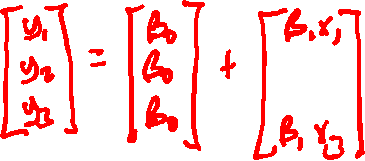
Rewriting our 3 Equations in Vector Notation
$$y_{1}=β_{0}+β_{1}x_{1}$$
$$y_{2}=β_{0}+β_{1}x_{2}$$
$$y_{3}=β_{0}+β_{1}x_{3}$$

Slide 17


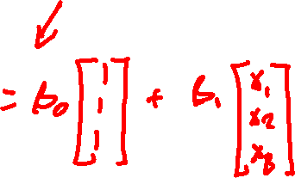
Rewriting our 3 Equations in Vector Notation
$$\left[\begin{matrix}y_{1} \\ y_{2} \\ y_{3}\end{matrix}\right]=\left[\begin{matrix}β_{0} \\ β_{0} \\ β_{0}\end{matrix}\right]+\left[\begin{matrix}β_{1}x_{1} \\ β_{1}x_{2} \\ β_{1}x_{3}\end{matrix}\right]$$

Slide 18




Drawing them in 3D space
$$Y$$
$$\left[\begin{matrix}y_{1} \\ y_{2} \\ y_{3}\end{matrix}\right]=β_{0}\left[\begin{matrix}1 \\ 1 \\ 1\end{matrix}\right]+β_{1}\left[\begin{matrix}x_{1} \\ x_{2} \\ x_{3}\end{matrix}\right]$$
$$1$$
$$X$$

Slide 19


Drawing them in 3D space
$$Y$$
$$\left[\begin{matrix}y_{1} \\ y_{2} \\ y_{3}\end{matrix}\right]=β_{0}\left[\begin{matrix}1 \\ 1 \\ 1\end{matrix}\right]+β_{1}\left[\begin{matrix}x_{1} \\ x_{2} \\ x_{3}\end{matrix}\right]$$
$x$ and $1$ span a 2D plane.
$$1$$
$$x$$

Slide 20
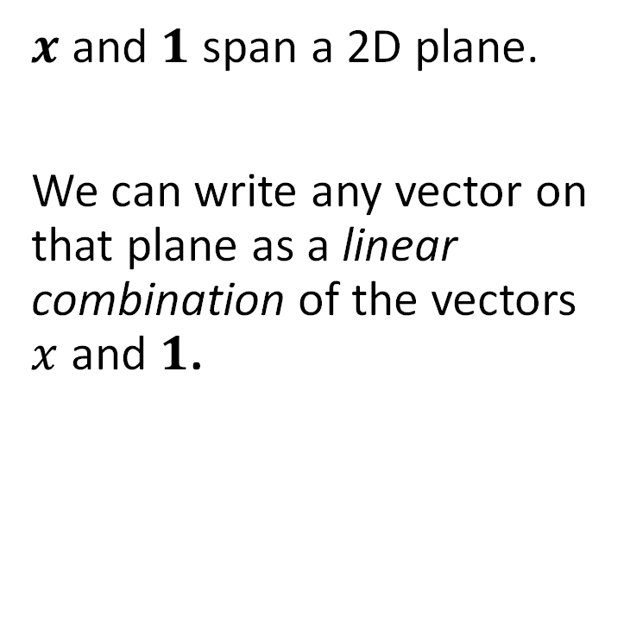
Drawing them in 3D space
$$Y$$
$x$ and $1$ span a 2D plane.
We can write any vector on that plane as a linear combination of the vectors $x$ and $1$.
$$1$$
$$x$$

Slide 21







Linear Solution
In a perfect world, $Y$ would lie on that plane.
$$\left(x_{3},y_{3}\right)$$
$$\left(x_{2},y_{2}\right)$$
$$\left(x_{1},y_{1}\right)$$
$$Y$$
$$1$$
$$x$$

Slide 22





Linear Regression
But it doesn’t. So we need to project it down onto our plane.
$$Y$$
$$\left(x_{3},y_{3}\right)$$
$$\left(x_{1},y_{1}\right)$$
$$\left(x_{2},y_{2}\right)$$
$$1$$
$$x$$

Slide 23
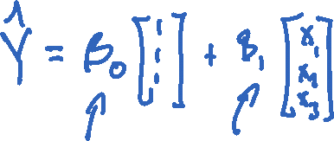
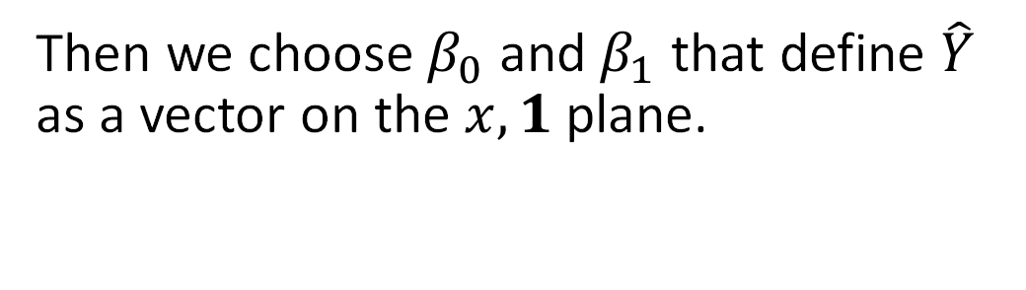

Linear Regression
Then we choose $β_{0}$ and $β_{1}$ that define $\hat{Y}$ as a vector on the $x, 1$ plane.
$$Y$$
$$\hat{Y}$$
$$1$$
$$x$$

Slide 24
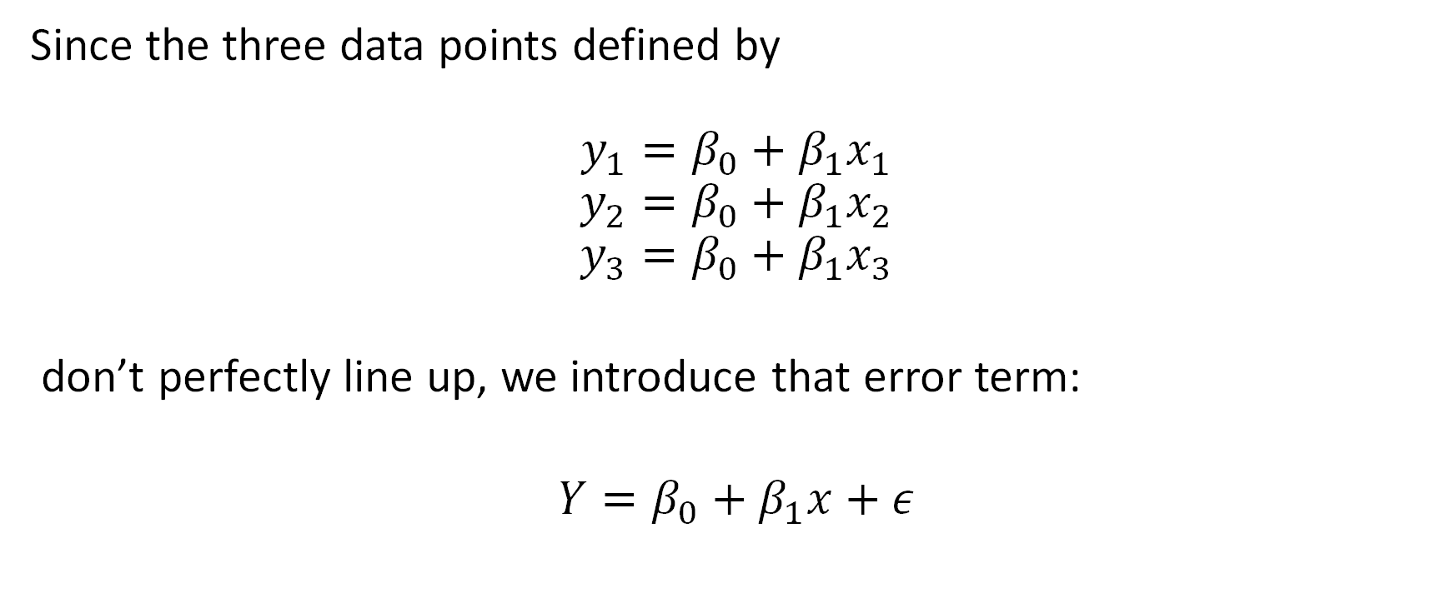
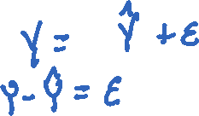
Rewriting our 3 Equations in Vector Notation… again
Since the three data points defined by
$$y_{1}=β_{0}+β_{1}x_{1}$$
$$y_{2}=β_{0}+β_{1}x_{2}$$
$$y_{3}=β_{0}+β_{1}x_{3}$$
don’t perfectly line up, we introduce that error term:
$$Y=β_{0}+β_{1}x+ε$$

Slide 25


Linear Regression
$$Y−\hat{Y}=ε$$
$$Y$$
$$\hat{Y}$$
$$1$$
$$x$$

Slide 26

Linear Regression as a Projection
Thus, we need an Orthogonal Projection to get us to our $\hat{Y}$ from $Y$.
$$Y$$
$$\hat{Y}$$
$$1$$
$$x$$

Slide 27





Solving for $β_{0}$ and $β_{1}$.
We use the properties of orthogonality and the dot product to write:
$$\left(Y−\hat{Y}\right)⋅1=0$$
$$\left(Y−\hat{Y}\right)⋅x=0$$

Slide 28


Solving for $β_{0}$ and $β_{1}$.
A little manipulation:
$$Y⋅1−\hat{Y}⋅1=0$$
$$Y⋅x−\hat{Y}⋅x=0$$

Slide 29

Solving for $β_{0}$ and $β_{1}$.
A little manipulation:
$$Y⋅1=\hat{Y}⋅1$$
$$Y⋅x=\hat{Y}⋅x$$

Slide 30

Solving for $β_{0}$ and $β_{1}$.
Since dot products are commutative:
$$1⋅Y=1⋅\hat{Y}$$
$$x⋅Y=x⋅\hat{Y}$$

Slide 31

Solving for $β_{0}$ and $β_{1}$.
Swapping sides:
$$1⋅\hat{Y}=1⋅Y$$
$$x⋅\hat{Y}=x⋅Y$$

Slide 32


Solving for $β_{0}$ and $β_{1}$.
Substituting $\hat{Y}={\hat{β}}_{0}1+{\hat{β}}_{1}X$:
$$1⋅\hat{Y}=1⋅Y$$
$$x⋅\hat{Y}=x⋅Y$$

Slide 33


Solving for $β_{0}$ and $β_{1}$.
Then we can distribute:
$$1⋅\left({\hat{β}}_{0}1+{\hat{β}}_{1}x\right)=1⋅Y$$
$$x⋅({\hat{β}}_{0}1+{\hat{β}}_{1}x)=x⋅Y$$

Slide 34

Solving for $β_{0}$ and $β_{1}$.
And then rewrite this in matrix notation:
$${\hat{β}}_{0}1⋅1+{\hat{β}}_{1}1⋅x=1⋅Y$$
$${\hat{β}}_{0}x⋅1+{\hat{β}}_{1}x⋅x=x⋅Y$$

Slide 35
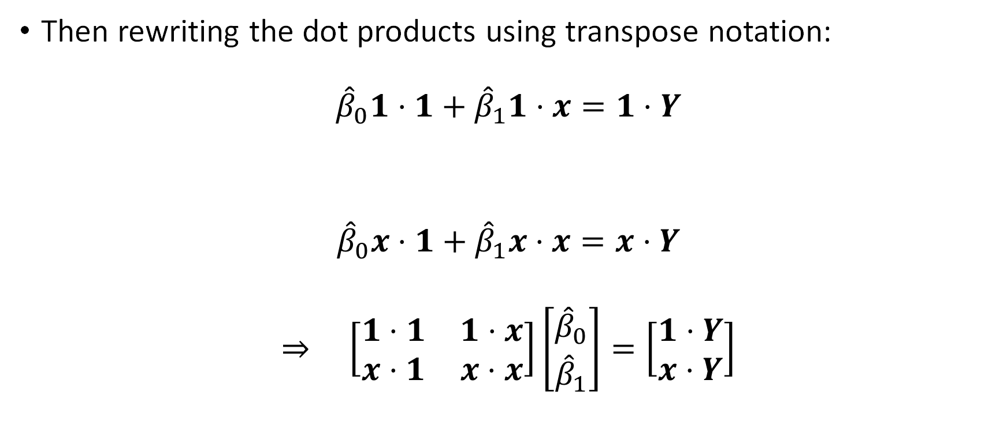

Solving for $β_{0}$ and $β_{1}$.
Then rewriting the dot products using transpose notation:
$${\hat{β}}_{0}1⋅1+{\hat{β}}_{1}1⋅x=1⋅Y$$
$${\hat{β}}_{0}x⋅1+{\hat{β}}_{1}x⋅x=x⋅Y$$
$$⇒ \left[\begin{matrix}1⋅1 & 1⋅x \\ x⋅1 & x⋅x\end{matrix}\right]\left[\begin{matrix}{\hat{β}}_{0} \\ {\hat{β}}_{1}\end{matrix}\right]=\left[\begin{matrix}1⋅Y \\ x⋅Y\end{matrix}\right]$$

Slide 36

Solving for $β_{0}$ and $β_{1}$.
Now we can decompose:
$$\left[\begin{matrix}1⋅1 & 1⋅x \\ x⋅1 & x⋅x\end{matrix}\right]\left[\begin{matrix}{\hat{β}}_{0} \\ {\hat{β}}_{1}\end{matrix}\right]=\left[\begin{matrix}1⋅Y \\ x⋅Y\end{matrix}\right]$$
$$⇒ \left[\begin{matrix}1^{T}1 & 1^{T}x \\ x^{T}1 & x^{T}x\end{matrix}\right]\left[\begin{matrix}{\hat{β}}_{0} \\ {\hat{β}}_{1}\end{matrix}\right]=\left[\begin{matrix}1^{T}Y \\ x^{T}Y\end{matrix}\right]$$

Slide 37

Solving for $β_{0}$ and $β_{1}$.
Now we can decompose:
$$\left[\begin{matrix}1^{T}1 & 1^{T}x \\ x^{T}1 & x^{T}x\end{matrix}\right]\left[\begin{matrix}{\hat{β}}_{0} \\ {\hat{β}}_{1}\end{matrix}\right]=\left[\begin{matrix}1^{T}Y \\ x^{T}Y\end{matrix}\right]$$
$$⇒ \left[\begin{matrix}1^{T} \\ x^{T}\end{matrix}\right]\left[\begin{matrix}1 & x\end{matrix}\right] \left[\begin{matrix}{\hat{β}}_{0} \\ {\hat{β}}_{1}\end{matrix}\right]=\left[\begin{matrix}1^{T} \\ x^{T}\end{matrix}\right]Y$$

Slide 38

The Design Matrix
We define the design matrix $X:$
$$X≔[\begin{matrix}1 & x\end{matrix}]$$
$$X=\left[\begin{matrix}1 & x_{1} \\ 1 & x_{2} \\ 1 & x_{3}\end{matrix}\right]$$
using our three data point example.

Slide 39

The Design Matrix
More generally:
$$X≔[\begin{matrix}1 & x\end{matrix}]$$
$$X=\left[\begin{matrix}1 & x_{1} \\ 1 & x_{2} \\ ⋮ & ⋮ \\ 1 & x_{n}\end{matrix}\right]$$
for $n$ observations. (It is harder to draw $ℝ^{n}$ space).

Slide 40

The Design Matrix
The column space of $X$ is a 2-dimensional plane (subspace) in $ℝ^{n}$.
$$Y$$
$$\hat{Y}$$
$$1$$
$$x$$

Slide 41

The Design Matrix
The design matrix
$$X≔[\begin{matrix}1 & x\end{matrix}]$$
is the same that we saw in Python and statsmodels. We will see it again.

Slide 42


Back to Solving for $β_{0}$ and $β_{1}$.
So we can insert our design matrix $X$:
$$\left[\begin{matrix}1^{T} \\ x^{T}\end{matrix}\right]\left[\begin{matrix}1 & x\end{matrix}\right] \left[\begin{matrix}{\hat{β}}_{0} \\ {\hat{β}}_{1}\end{matrix}\right]=\left[\begin{matrix}1^{T} \\ x^{T}\end{matrix}\right]Y$$

Slide 43

Back to Solving for $β_{0}$ and $β_{1}$.
So we can insert our design matrix $X$:
$$\left[\begin{matrix}1^{T} \\ x^{T}\end{matrix}\right]\left[\begin{matrix}1 & x\end{matrix}\right] \left[\begin{matrix}{\hat{β}}_{0} \\ {\hat{β}}_{1}\end{matrix}\right]=\left[\begin{matrix}1^{T} \\ x^{T}\end{matrix}\right]Y$$
$$X^{T}X\left[\begin{matrix}{\hat{β}}_{0} \\ {\hat{β}}_{1}\end{matrix}\right]=X^{T}Y$$

Slide 44

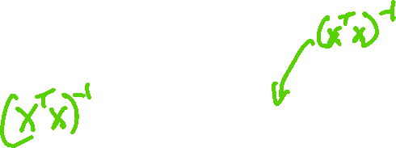
Back to Solving for $β_{0}$ and $β_{1}$.
Now we isolate $β_{0}$ and $β_{1}$:
$$X^{T}X\left[\begin{matrix}{\hat{β}}_{0} \\ {\hat{β}}_{1}\end{matrix}\right]=X^{T}Y$$

Slide 45

Back to Solving for $β_{0}$ and $β_{1}$.
Now we isolate $β_{0}$ and $β_{1}$:
$$X^{T}X\left[\begin{matrix}{\hat{β}}_{0} \\ {\hat{β}}_{1}\end{matrix}\right]=X^{T}Y$$
$$\left[\begin{matrix}{\hat{β}}_{0} \\ {\hat{β}}_{1}\end{matrix}\right]={\left(X^{T}X\right)}^{−1}X^{T}Y$$

Slide 46

The Hat Matrix
We have just shown that $\left[\begin{matrix}{\hat{β}}_{0} \\ {\hat{β}}_{1}\end{matrix}\right]={\left(X^{T}X\right)}^{−1}X^{T}Y$.
How can we write the predicted values, $\hat{Y}$, in terms of $\hat{β}$= $\left[\begin{matrix}{\hat{β}}_{0} \\ {\hat{β}}_{1}\end{matrix}\right]$?

Slide 47
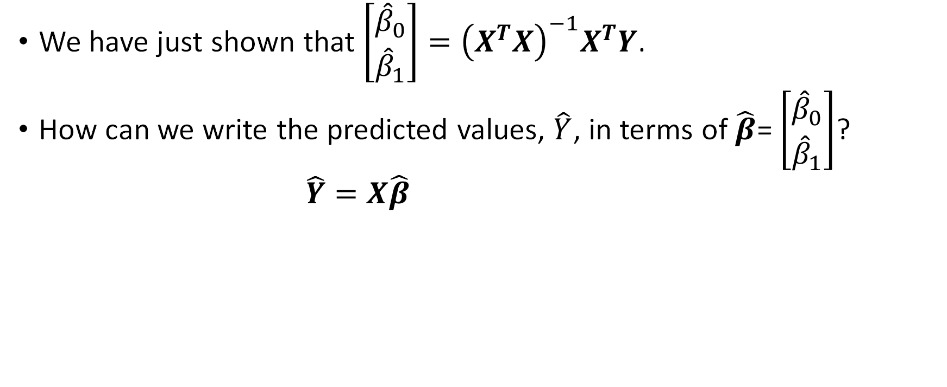
The Hat Matrix
We have just shown that $\left[\begin{matrix}{\hat{β}}_{0} \\ {\hat{β}}_{1}\end{matrix}\right]={\left(X^{T}X\right)}^{−1}X^{T}Y$.
How can we write the predicted values, $\hat{Y}$, in terms of $\hat{β}$= $\left[\begin{matrix}{\hat{β}}_{0} \\ {\hat{β}}_{1}\end{matrix}\right]$?
$$\hat{Y}=X\hat{β}=X{\left(X^{T}X\right)}^{−1}X^{T}Y$$

Slide 48
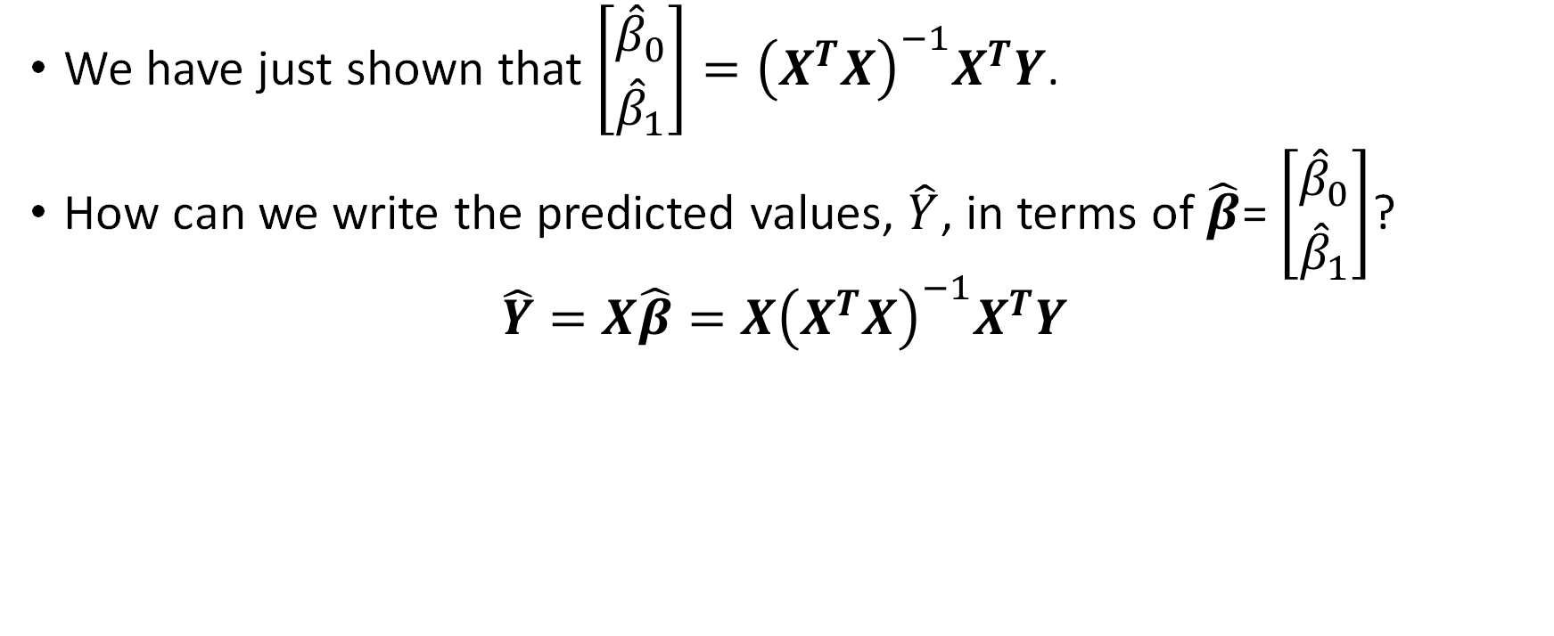
The Hat Matrix
We have just shown that $\left[\begin{matrix}{\hat{β}}_{0} \\ {\hat{β}}_{1}\end{matrix}\right]={\left(X^{T}X\right)}^{−1}X^{T}Y$.
How can we write the predicted values, $\hat{Y}$, in terms of $\hat{β}$= $\left[\begin{matrix}{\hat{β}}_{0} \\ {\hat{β}}_{1}\end{matrix}\right]$?
$$\hat{Y}=X\hat{β}=X{\left(X^{T}X\right)}^{−1}X^{T}Y$$

Slide 49
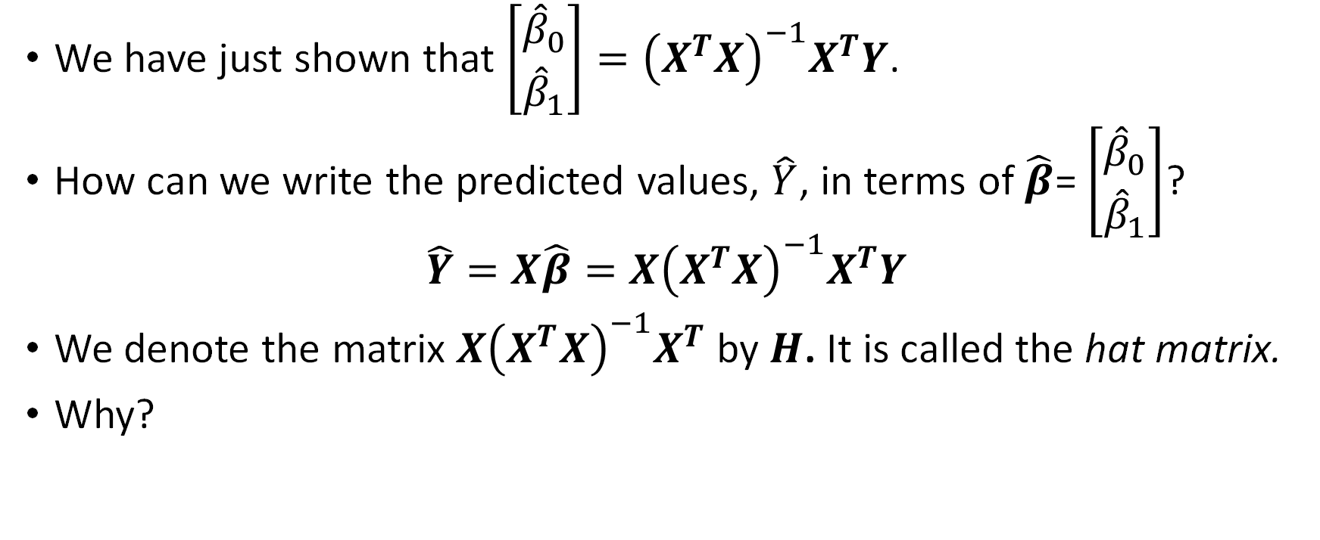

The Hat Matrix
We have just shown that $\left[\begin{matrix}{\hat{β}}_{0} \\ {\hat{β}}_{1}\end{matrix}\right]={\left(X^{T}X\right)}^{−1}X^{T}Y$.
How can we write the predicted values, $\hat{Y}$, in terms of $\hat{β}$= $\left[\begin{matrix}{\hat{β}}_{0} \\ {\hat{β}}_{1}\end{matrix}\right]$?
$$\hat{Y}=X\hat{β}=X{\left(X^{T}X\right)}^{−1}X^{T}Y$$
We denote the matrix $X{\left(X^{T}X\right)}^{−1}X^{T}$ by $H$. It is called the hat matrix.
Why?

Slide 50


Properties of the Hat Matrix
$$H≔X{\left(X^{T}X\right)}^{−1}X^{T}$$
The matrix $H$ has the following properties:
Symmetry:
$$H^{T}=H$$
Idempotent:
$$H^{2}=H$$
Influence:
$$\frac{∂{\hat{y}}_{i}}{∂y_{j}}=H_{i,j}$$
A matrix that satisfies (1) and (2) is called an orthogonal projection.

Slide 51


Properties of the Hat Matrix
A matrix that satisfies (1) and (2) is called an orthogonal projection.
Thus, $\hat{Y}=HY$ is the orthogonal projection of $Y$onto $\hat{Y},$ which lies on the $1,x$ plane.
$$Y$$
$$\hat{Y}$$
$$1$$
$$x$$

Slide 52










Takeaways
We just showed that simple linear regression, when written in matrix form, is a projection from the space of $n$ observations onto a subspace (plane) of $p+1=2$ parameters.
orthogonal projection $⇒$ least squares estimator
Why do we care?

Slide 53

The Design Matrix
The design matrix
$$X≔[\begin{matrix}1 & x\end{matrix}]$$
can be generalized:

Slide 54

The Design Matrix
The design matrix
$$X≔[\begin{matrix}1 & x\end{matrix}]$$
can be generalized:
$$X≔[\begin{matrix}1 & x_{1} & … & x_{p}\end{matrix}]$$
for $p$ predictor (input) variables.

Slide 55

The Design Matrix
$$X≔[\begin{matrix}1 & x_{1} & … & x_{p}\end{matrix}]$$
Hence, we can solve for $p+1$ parameters:
$$\hat{β}=\left[\begin{matrix}{\hat{β}}_{0} \\ {\hat{β}}_{1} \\ ⋮ \\ {\hat{β}}_{p}\end{matrix}\right]$$

Slide 56

Et Voilá
We have Multiple Linear Regression!
$$\hat{Y}=HY$$
(without multivariable calculus).
If $X$ has $p$ predictors, the fitted subspace has dimension $p+1$
The residual space has dimension $n−p−1$.

